Slide 1
Software Development Life Cycle (SDLC)

Slide 2
SDLC Model
A framework that describes the activities performed at each stage of a software development project.

Slide 3
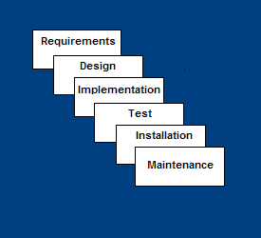
Waterfall Model
Requirements – defines needed information, function, behavior, performance and interfaces.
Design – data structures, software architecture, interface representations, algorithmic details.
Implementation – source code, database, user documentation, testing.

Slide 4
Waterfall Strengths
Easy to understand, easy to use
Provides structure to inexperienced staff
Milestones are well understood
Sets requirements stability
Good for management control (plan, staff, track)
Works well when quality is more important than cost or schedule

Slide 5
Waterfall Deficiencies
All requirements must be known upfront
Deliverables created for each phase are considered frozen – inhibits flexibility
Can give a false impression of progress
Does not reflect problem-solving nature of software development – iterations of phases
Integration is one big bang at the end
Little opportunity for customer to preview the system (until it may be too late)

Slide 6
When to use the Waterfall Model
Requirements are very well known
Product definition is stable
Technology is understood
New version of an existing product
Porting an existing product to a new platform.

Slide 7
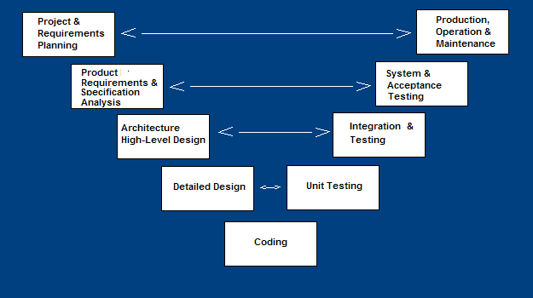
V-Shaped SDLC Model
A variant of the Waterfall that emphasizes the verification and validation of the product.
Testing of the product is planned in parallel with a corresponding phase of development

Slide 8
V-Shaped Steps
Project and Requirements Planning – allocate resources
Product Requirements and Specification Analysis – complete specification of the software system
Architecture or High-Level Design – defines how software functions fulfill the design
Detailed Design – develop algorithms for each architectural component
Production, operation and maintenance – provide for enhancement and corrections
System and acceptance testing – check the entire software system in its environment
Integration and Testing – check that modules interconnect correctly
Unit testing – check that each module acts as expected
Coding – transform algorithms into software

Slide 9
V-Shaped Strengths
Emphasize planning for verification and validation of the product in early stages of product development
Each deliverable must be testable
Project management can track progress by milestones
Easy to use

Slide 10
V-Shaped Weaknesses
Does not easily handle concurrent events
Does not handle iterations or phases
Does not easily handle dynamic changes in requirements
Does not contain risk analysis activities

Slide 11
When to use the V-Shaped Model
Excellent choice for systems requiring high reliability – hospital patient control applications
All requirements are known up-front
When it can be modified to handle changing requirements beyond analysis phase
Solution and technology are known

Slide 12
Prototyping Model
Developers build a prototype during the requirements phase
Prototype is evaluated by end users
Users give corrective feedback
Developers further refine the prototype
When the user is satisfied, the prototype code is brought up to the standards needed for a final product.

Slide 13
Prototyping model Steps
A preliminary project plan is developed
An partial high-level paper model is created
The model is source for a partial requirements specification
A prototype is built with basic and critical attributes
The designer builds
  the database
  user interface
  algorithmic functions
The designer demonstrates the prototype, the user evaluates for problems and suggests improvements.
This loop continues until the user is satisfied

Slide 14
Prototyping model Strengths
Users are actively involved in the development
Since in this methodology a working model of the system is provided, the users get a better understanding of the system being developed.
Errors can be detected much earlier.
Quicker user feedback is available leading to better solutions.
Missing functionality can be identified easily
Confusing or difficult functions can be identified
Requirements validation, Quick implementation of, incomplete, but
functional, application.

Slide 15
Disadvantages of Prototyping model:
Leads to implementing and then repairing way of building systems.
Practically, this methodology may increase the complexity of the system as scope of the system may expand beyond original plans.
Incomplete application may cause application not to be used as the
full system was designed
Incomplete or inadequate problem analysis

Slide 16
When to use
Prototyping model
Requirements are unstable or have to be clarified
Technical issues need to be resolved.
Short-lived demonstrations

Slide 17
Incremental model
In incremental model the whole requirement is divided into various builds.
Multiple development cycles take place here, making the life cycle a “multi-waterfall” cycle.
Cycles are divided up into smaller, more easily managed modules. Each module passes through the requirements, design, implementation and testing phases.

Slide 18
Incremental Model
A working version of software is produced during the first module, so you have working software early on during the software life cycle.
Each subsequent release of the module adds function to the previous release. The process continues till the complete system is achieved.

Slide 19

Examples of incremental model

Slide 20
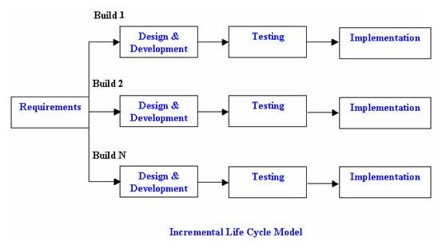
Diagram of incremental model

Slide 21
Advantages of Incremental model:
Generates working software quickly and early during the software life cycle.
This model is more flexible – less costly to change scope and requirements.
It is easier to test and debug during a smaller iteration.
In this model customer can respond to each built.
Lowers initial delivery cost.
Easier to manage risk because risky pieces are identified and handled during it’d iteration.

Slide 22
Disadvantages of Incremental model:
Needs good planning and design.
Needs a clear and complete definition of the whole system before it can be broken down and built incrementally.
Total cost is higher than waterfall.

Slide 23
When to use the Incremental model:
This model can be used when the requirements of the complete system are clearly defined and understood.
Major requirements must be defined; however, some details can evolve with time.
There is a need to get a product to the market early.
A new technology is being used
Resources with needed skill set are not available
There are some high risk features and goals.

Slide 24
Rapid Application Model (RAD)
Requirements planning phase (a workshop utilizing structured discussion of business problems)
User description phase – automated tools capture information from users
Construction phase – productivity tools, such as code generators, screen generators, etc. inside a time-box. (“Do until done”)
Cutover phase -- installation of the system, user acceptance testing and user training

Slide 25
Rapid Application development
It is a type of incremental model.
In RAD model the components or functions are developed in parallel as if they were mini projects.
The developments are time boxed, delivered and then assembled into a working prototype.
This can quickly give the customer something to see and use and to provide feedback regarding the delivery and their requirements.

Slide 26
Phases of RAD model
Communication:
Understand the business problem and information characteristics.
Planning:
Multiple teams works in parallel
Modeling:
Establishes design representation
Construction:
Use of pre existing components and application of automated code generation.

Slide 27
Modeling
Business modeling: The information flow is identified between various business functions.
Data modeling: Information gathered from business modeling is used to define data objects that are needed for the business.
Process modeling: Data objects defined in data modeling are converted to achieve the business information flow to achieve some specific business objective.

Slide 28
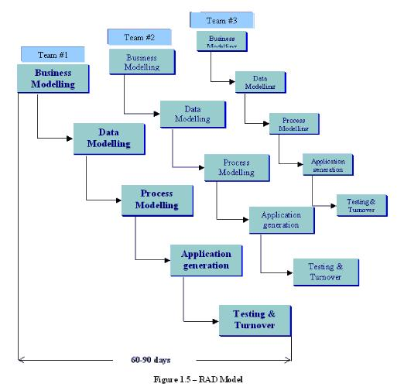
RAD model

Slide 29
Advantages of the RAD model:
Reduced development time.
Increases reusability of components
Quick initial reviews occur
Encourages customer feedback
Integration from very beginning solves a lot of integration issues.

Slide 30
Disadvantages of RAD model:
Depends on strong team and individual performances for identifying business requirements.
Only system that can be modularized can be built using RAD
Requires highly skilled developers/designers.
High dependency on modeling skills
Inapplicable to cheaper projects as cost of modeling and automated code generation is very high.

Slide 31
When to use RAD model:
When costs and risk evaluation is important
For medium to high-risk projects
Long-term project commitment unwise because of potential changes to economic priorities
Users are unsure of their needs
Requirements are complex
New product line
Significant changes are expected (research and exploration)

Slide 32
Spiral Model
The spiral model is similar to the incremental model, with more emphasis placed on risk analysis.
The spiral model has four phases:
Planning
Risk Analysis
Engineering
Evaluation.

Slide 33
Spiral Model
A software project repeatedly passes through these phases in iterations (called Spirals in this model).
The baseline spiral, starting in the planning phase, requirements are gathered and risk is assessed. Each subsequent spirals builds on the baseline spiral.

Slide 34
Phases of spiral model
Planning Phase: Requirements are gathered during the planning phase. Requirements like ‘BRS’ that is ‘Bussiness Requirement Specifications’ and ‘SRS’ that is ‘System Requirement specifications’.
Risk Analysis: In the risk analysis phase, a process is undertaken to identify risk and alternate solutions. A prototype is produced at the end of the risk analysis phase. If any risk is found during the risk analysis then alternate solutions are suggested and implemented.
Engineering Phase: In this phase software is developed, along with testing at the end of the phase. Hence in this phase the development and testing is done.
Evaluation phase: This phase allows the customer to evaluate the output of the project to date before the project continues to the next spiral.

Slide 35
Advantages of Spiral model:
High amount of risk analysis hence, avoidance of Risk is enhanced.
Good for large and mission-critical projects.
Strong approval and documentation control.
Additional Functionality can be added at a later date.
Software is produced early in the software life cycle.

Slide 36
Disadvantages of Spiral model:
Can be a costly model to use.
Risk analysis requires highly specific expertise.
Project’s success is highly dependent on the risk analysis phase.
Doesn’t work well for smaller projects.

Slide 37
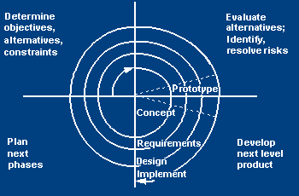
Spiral SDLC Model
Adds risk analysis, and 4gl RAD prototyping to the waterfall model
Each cycle involves the same sequence of steps as the waterfall process model

Slide 38
Spiral Quadrant
Determine objectives, alternatives and constraints
Objectives: functionality, performance, hardware/software interface, critical success factors, etc.
Alternatives: build, reuse, buy, sub-contract, etc.
Constraints: cost, schedule, interface, etc.

Slide 39
Spiral Quadrant
Evaluate alternatives, identify and resolve risks
Study alternatives relative to objectives and constraints
Identify risks (lack of experience, new technology, tight schedules, poor process, etc.
Resolve risks (evaluate if money could be lost by continuing system development

Slide 40
Spiral Quadrant
Develop next-level product
Typical activites:
  Create a design
  Review design
  Develop code
  Inspect code
  Test product

Slide 41
Spiral Quadrant
Plan next phase
Typical activities
  Develop project plan
  Develop configuration management plan
  Develop a test plan
  Develop an installation plan

Slide 42
When to use Spiral Model
When creation of a prototype is appropriate
When costs and risk evaluation is important
For medium to high-risk projects
Long-term project commitment unwise because of potential changes to economic priorities
Users are unsure of their needs
Requirements are complex
New product line
Significant changes are expected (research and exploration)

